Slide 1


Operational Perspectives & Priorities
SHECA 2018
Rochelle Owen, Dalhousie University
Paul Martin, University of Western Ontario
Prof. Caroline Begg, McGill University

Slide 2
Session Overview
SHECA 2018
Rochelle Owen (10min)
Paul Martin (10min)
Caroline Begg (10min)
Cross Country Check-up (45min)

Slide 3
Operational Sustainability in Higher Education
Trends and priorities
SHECA 2018
Rochelle Owen, Dalhousie University

Slide 4
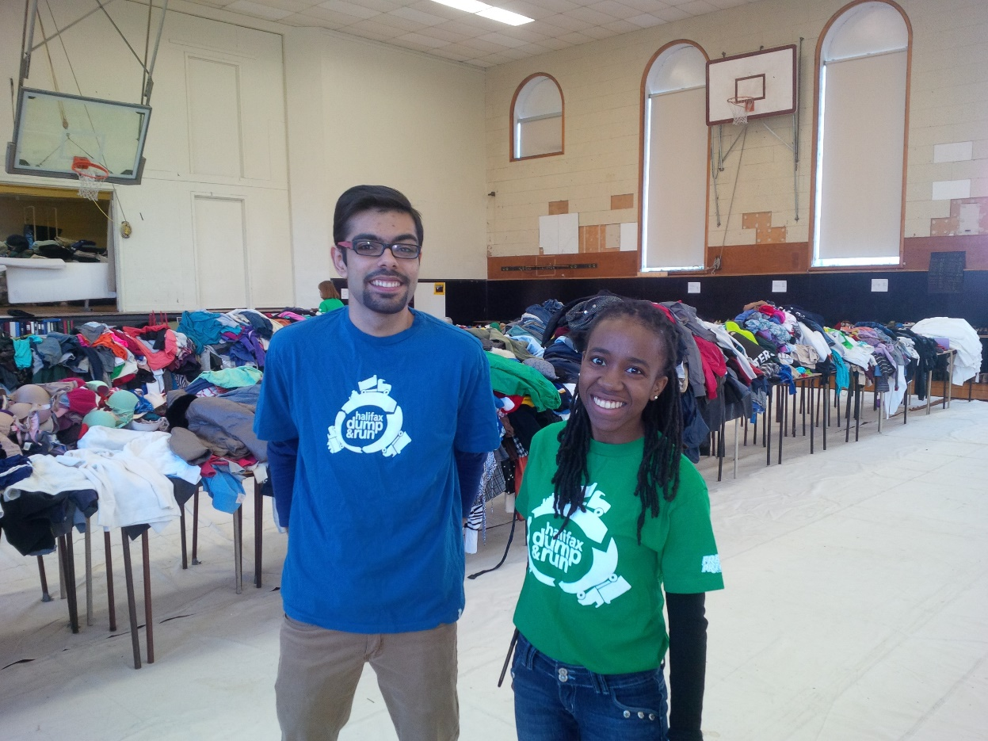
Engagement
SHECA 2018
Increased growth in Sustainability Offices and the levels of positions and structures
Student interest and mobilization around issues such as climate change and food.
Key Approaches: Social and community engagement, applied research (campus as a living lab), partnerships on and off campus, measurement based.

Slide 5
Reporting & Monitoring
SHECA 2018
University Sustainability Reports
Third-Party Reporting –Ex. STARS
EMIS – Energy Management Information Systems

Slide 6

Breadth of Issues
SHECA 2018
Transportation Demand Management
Energy and Climate
Water
Food
Procurement
Waste
Natural Environment
Social Sustainability

Slide 7
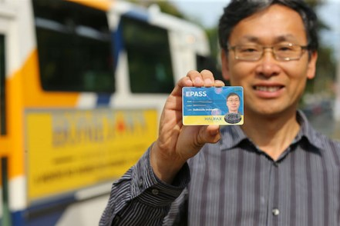
Energy and Climate Change
SHECA 2018
  District Energy and Combined Heat and Power
  Green Building – New Construction and Major Existing Building Retrofits
  Full Scale – Energy Building Retrofits
  System and product upgrades
  Building Optimization Initiatives
  Renewable energy
  Transportation Demand Management

Slide 8
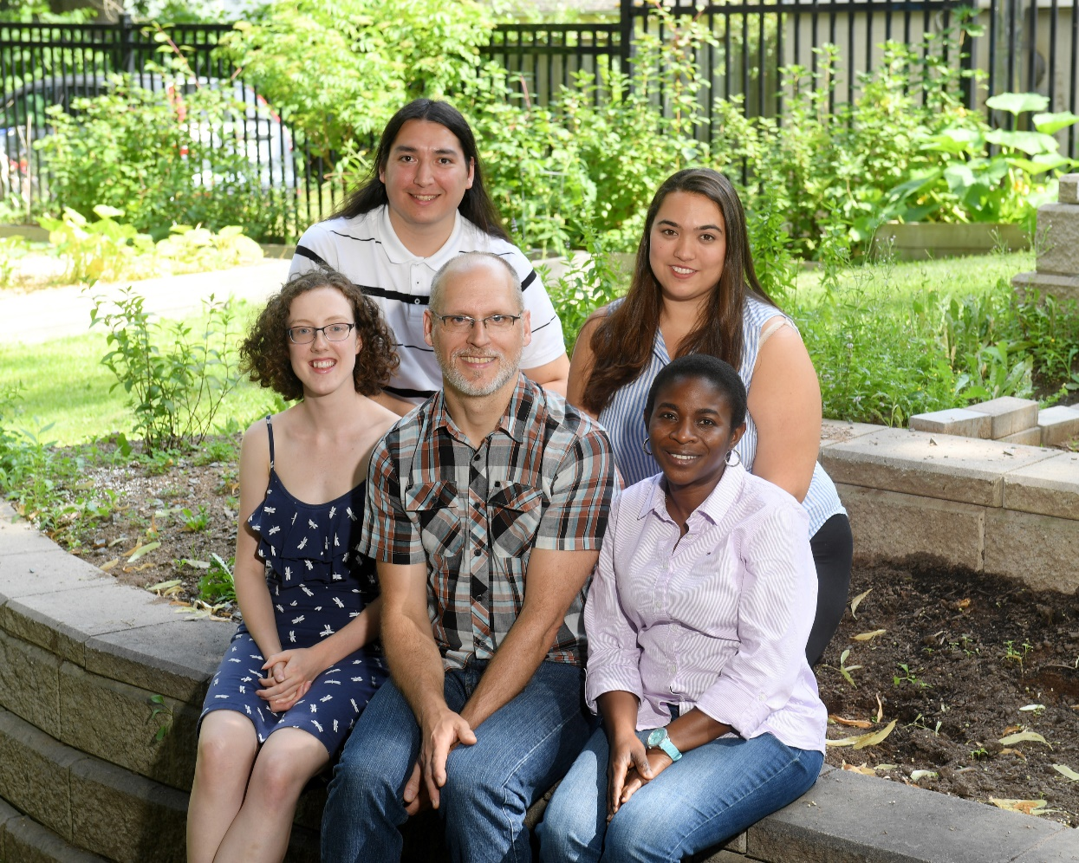
Investments
SHECA 2018
  Proactively pursuing partnerships (ex. RNG)
  People - Supporting diversity
  Identifying funding models and securing, managing financing
  Strategic partnerships

Slide 9
We Do University-Wide Sustainability:
Planning
Monitoring & Reporting
Projects
Behavioural Initiatives
How We Do it:
Gov., Community and Campus Partnerships
Creating Organizational Systems/Standards
Green project developer approach
Applied Research & Student Engagement

Slide 10
View from the Director’s Chair
Carbon pricing, new funding sources, and the mainstreaming of sustainability
SHECA 2018
Paul Martin, Western University

Slide 11
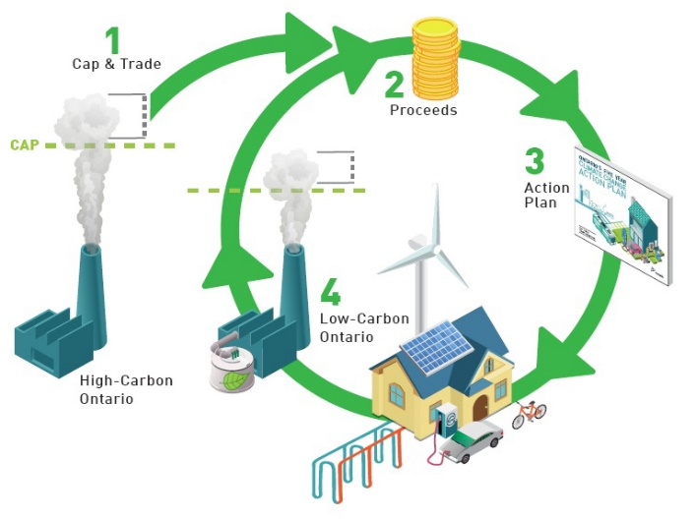
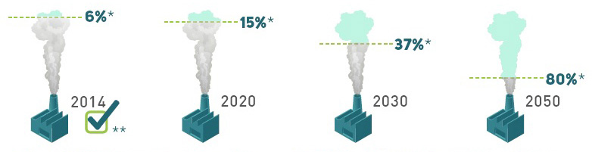
Ontario’s Climate Change Action Plan
SHECA 2018
Designed to move Ontario to a low carbon economy
  Cap & Trade
  Green Energy Bank
  Research and Innovation
Carbon Reduction based on 1990 level
  2020 – 15% reduction
  2030 – 37% reduction
  2050 – 80% reduction
Notes:
The Ontario climate change action plan is the plan Ontario developed to move the province to a low carbon economy
- Major pieces Cap & Trade; Green energy Bank both designed to spur research and innovation in Ontario to reduce the dependency on carbon.
- Carbon reduction targets over the next 30 years to move Ontario to a low-carbon economy by setting and reducing caps on carbon emissions for Ontario

Slide 12


Ontario’s Cap & Trade Plan
SHECA 2018
Cap & Trade
  Auctions to sell allowances
    $1.8 to $2.0 Billion
    Provide funds to incent GHG reductions
  Free Allowances to:
    Companies at risk of leaving the province (carbon leakage)
    Public institution
  - Three types of participants:
    Mandatory – above 25 K tonnes
    Voluntary – between 10 K – 25 K tonnes
    Non-participants – under 10 K tonnes
  Link with California and Quebec
Notes:
Cap & Trade – is the mechanism for putting a price on carbon and charging those the emit Greenhouse Gases
Funds collected from carbon auctions must be used for projects designed to reduce GHG
Rules stop carbon leakage by taxing goods brought in from economies that do not have a cost on carbon
Almost all areas of the economy are impacted 85 to 90%
Free allowance provided to allow companies and institutions to adjust to the cost of carbon
Three type of participants created
Above 25,000 tonnes are mandatory and must administer their own GHG emissions
Those between 10,000 and 25,000 tonnes can opt in but must report yearly emissions.
Those under 10,000 tonnes their emissions will be administered by the distributors
Linkage with Quebec and California will provide a secondary market and help keep carbon prices low

Slide 13


Higher Ed Community
Actively Engaged in GHG reductions
SHECA 2018
University and College sector actively engaged reducing Greenhouse Gases (GHG)
  Switch from steam heating to hot water heating
  Deep energy retrofits (heat recovery)
Sector has all three types of participants:
  Mandatory, Voluntary and Non-participants
Notes:
The Ontario’s college and university sector has been actively reducing GHG for years with some institutions moving to hot water heating years ago.
The sector has 7 Universities who are mandatory participants; 4 Universities who are voluntary participants and the remaining
Universities and all of the colleges are non-participants.

Slide 14

Higher Ed Community
Impact of Cap & Trade on Sector
SHECA 2018
Cap & Trade Participants
  11 Universities are participants
    Received free allowances
  All the colleges and the remaining Universities are non-participants
    Paid gas utilities $0.04 per M3
Greenhouse Gas Reduction Plan
  Non-participants received funds equal to free allowances
  Participants and non-participants both eligible for innovation fund
Notes:
Free allowances
- Higher Ed sector received free allowance with no cap decline for the first 4 year reporting period
- Non-participants received the equilent of $18 per ton of GHG based on their 2015 GHG emissions
$22 M Universities
$67 M Colleges
Innovation competition:
$78 M Universities
$33 M Colleges

Slide 15
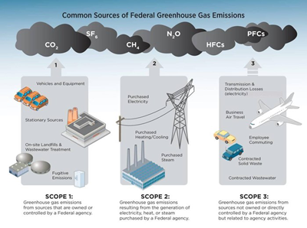

Higher Ed Sector Funding
SHECA 2018
Grant funding requirements:
Non-participants
  GHG scope 1 reduction & scope 2
  Spend grant by March 31, 2019
  Project preapproved by Ministry
  Regular reporting required
Innovation Program
  Same as above plus each project ranked by a group of peers and ranked
Loan Fund - $300 M
  Projects preapproved by Ministry
  GHG scope 1 reduction
  Project finished by March 31, 2021
  No advance on funds, loan repayable in 20 equal installments
Notes:
Grant Funding
Time requirement was the biggest hurdle and one we negotiated with the ministry to get 23 months for spending the funds rather then the normal 12 months
Innovation fund required institutions to compete against each other for funding with Scope 1 GHG reduction being the main focus and the cost of reducing GHG being a close 2nd
Loan Fund
This fund is on hold while the Ontario election occurs
It is designed to reduce GHG scope 1 emissions but has a longer period for completion 30 to 33 months (we hope)
These funds are important for the institutions to reduce their GHG scope 1 emissions.

Slide 16
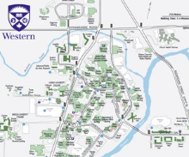
Western University
SHECA 2018
GHG emissions – 49.6 K tonnes
  Supplies Hospital steam
Mandatory participant
District heating system
  Core campus
  5 steam boilers
  Serves 80 buildings
20 stand alone buildings
Notes:
Western is a single campus University located in London Ontario Canada
Western is just over 10 M gross square feet
Western student population is just over 33,000 FTE; 38,000 FTE including our affiliated colleges.
Western has fourteen (14) residences and apartments capable of housing over 6,000 students
Our core buildings are serviced by a district heating plant and electrical and water service hubs.
20 of the buildings including most of the residences are stand alone having their own heating/cooling, electrical and water services provided directly from the service provider.

Slide 17
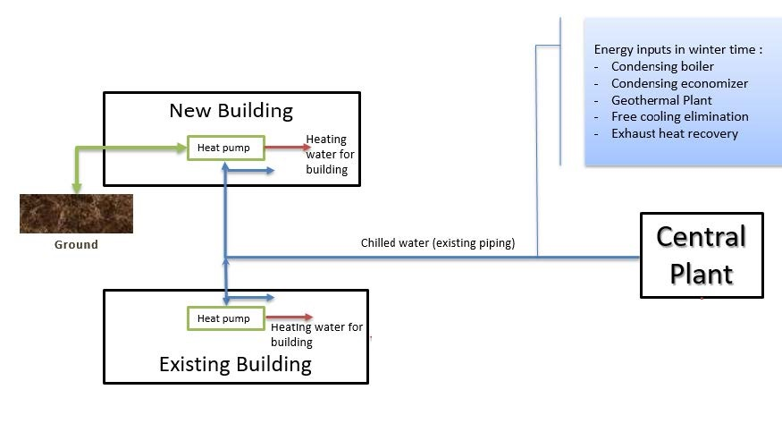
Western University GHG Reduction Plan
SHECA 2018
Deep energy retrofits on all buildings
Heat recovery (e.g. heat pumps, FGRU)
Convert campus from steam heating to low temperature heating water
Geothermal energy and solar Photovoltaic systems
Chilled water loop changed to thermal loop transferring excess heat to other buildings
Notes:
Deep energy retro fits will see the following:
Heat recovery heat pumps added to the buildings
New humidifiers (adiabatic, instead of steam)
Control sequences and air units will be optimized
LED lighting
Western is moving from Steam heating to low temperature hot water for heating our buildings using our chilled water loop as a thermal loop attached to various sources of heat including geo thermal and solar

Slide 18
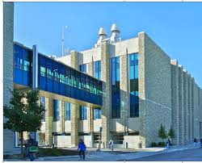
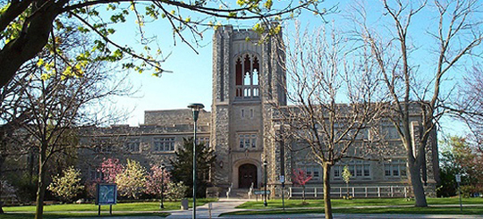
Western University GHG Reduction Projects
SHECA 2018
Deep energy retrofit and introduction of a heat pump into:
  New building < 10 years old
  Older building > 50 years old
LED lighting in both buildings
Optimization of chilled water system
Insulation installation
Installation of economizer on steam boiler
Notes:
Project includes
2 building deep energy retrofits
1 CPS optimization
1 Flue gas recovery unit added
Project will reduce 6,072 tons of GHG or 12% of Western scope 1 GHG emissions
Lighting and Chiller Plant optimization will reduce electricity usage by 2,889.6 MWh per year or 1.8% of Western’s yearly usage
Natural Gas like GHG will be reduced by 12% or 3,172,000 M3 per year

Slide 19
Bringing Students into the Fold
Students substantially contributing to food operations at McGill – Living Labs
SHECA 2018
Prof. Caroline Begg, McGill University

Slide 20
Student Engagement in
Sustainable Food Operations
SHECA 2018
The subject of my talk is the origin and impact of two student-run projects on sustainable food at McGill.
My role in the Macdonald-Student-run-Ecological-Garden (MSEG) and the Out-of-the-Garden-Project (OGP), has been as a mentor, supervisor of research projects/courses and as a resource person.
The projects started with active student interest, then a research project, accessing funding and then initiating the project.
The projects have focused on engaging with students and staff on both campuses. A key point has been maintaining communication with various departments and the administration.
Note MSEG has been in operation for 9 years and OGP for 5 years.

Slide 21
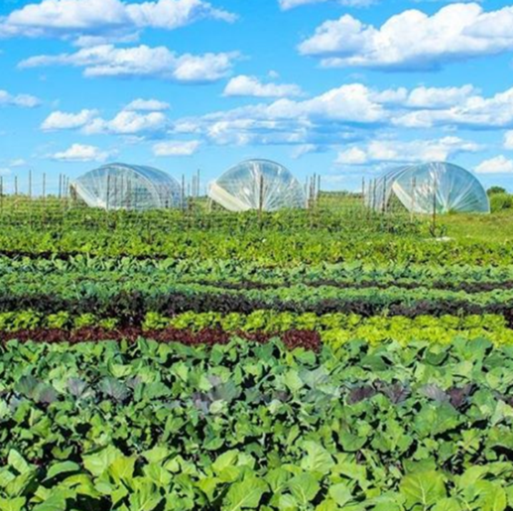
Macdonald Student Run Ecological Garden (MSEG)
SHECA 2018
MSEG was founded 2009 as 4 small plots (30 m²) in the Mac community garden.
It moved to the Hort centre, to a field in the Morgan Arboretum and since 2015 to its final place at the Macdonald Campus Farm
A 1.5 ha intensive vegetable farm: CSA and markets
MSEG’ s mission is to create a learning environment for-students-by-students and bridge the knowledge gap between food and farm. MSEG supports the movement towards higher awareness of food traceability and provide organically grown, ethical, local produce to the McGill and Montreal communities.

Slide 22
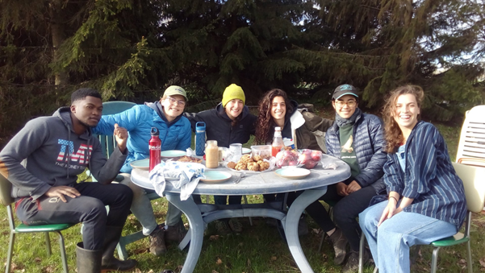

MSEG and Students
SHECA 2018
MSEG’ s management plan requires that students have a 2-year commitment. They are hired as interns the first year and then become managers the second year.
MSEG has 75 shares/baskets (90% to staff and students on both campuses) with the CSA and sales at 3 markets: Marché Ste Anne, McGill Farmers Market and Concordia.
MSEG managers and interns work 50 – 60 hours per week throughout the summer season, and a minimum of 25 hours per week during the school year.
2012 Catalyst Award, McGill Office of Sustainability; McGill Seeds of Change Crowd funding: MacAction High Tunnel (200% success); SPF funding 2010-2017

Slide 23

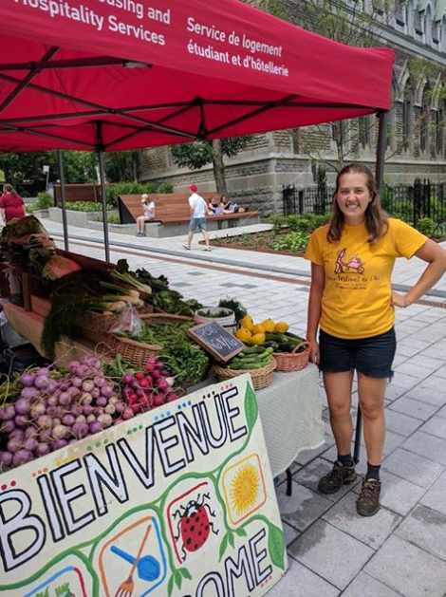
MSEG and the community
SHECA 2018
MSEG has reduced student rates for its baskets and provides recipes and how to cook all its vegetables.
MSEG offers educational tours for several McGill classes, student research projects, internships and extensive volunteer opportunities (over 100 days a year have volunteers working at MSEG).
McGill Farmers Market
Marché Ste Anne

Slide 24
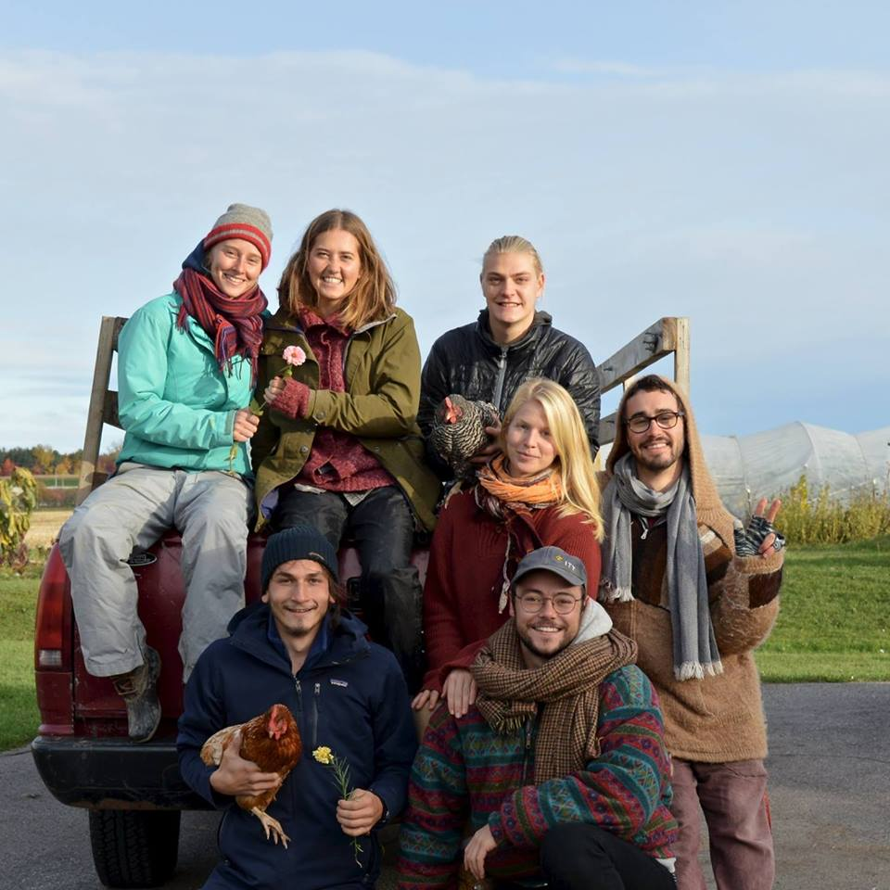
MSEG and Power Skills
SHECA 2018
MSEG’ s management strategy is built on education and communication.
Interns are trained from the beginning to successfully and efficiently manage a farm, and thus leave equipped with a base set of tools (HR, time management, budgeting etc.) with which to run a business.
Most of the students who have graduated from MSEG have gone onto careers in sustainable food systems
Interns and managers 2016

Slide 25

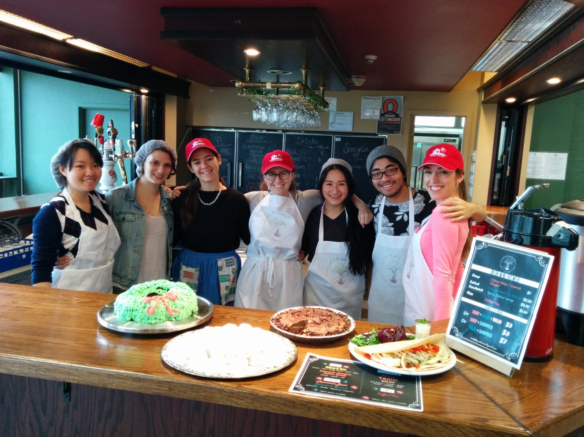
Out-of-the-Garden Project (OGP)
SHECA 2018
OGP, established Fall 2013 was based on a 4-student research project in 2012.
Students wanted meals that were reasonably priced, from local food sources and with diverse recipes.
OGP is one of only two on-site food outlets on the Mac campus.

Slide 26
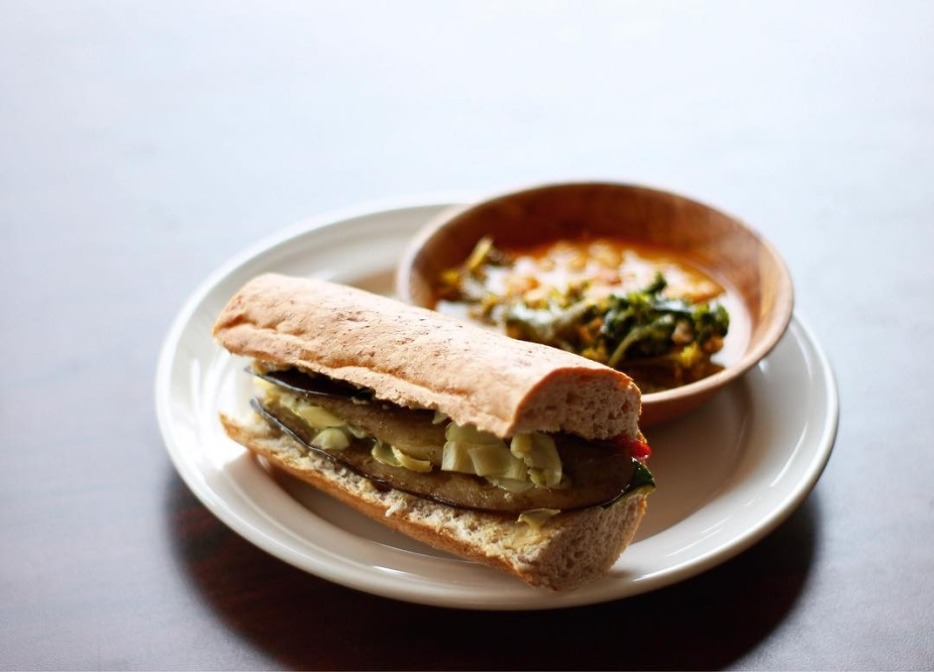
Out-of-the-Garden Project (OGP)
SHECA 2018
Mission statement: The primary goal of the project is to provide a healthy and sustainable food option for students.
The project aims to create a closed-loop food system in which food grown by the campus farms (MSEG, Horticulture Center and Mac poultry) is processed and served.
Food is also sourced from local farms. Disposable dishware items are minimized.
Awards received and grants applied for and received
Mary H Brown Endowment Fund: 2013, 2014, 2015
Sustainability Project Funds support 2013
Macdonald Campus Student Society funding 2013
McGill Catalyst Award 2014

Slide 27

Out-of-the-Garden Project (OGP)
SHECA 2018
OGP offers members the opportunity to gain experience in business, food preparation, food service, marketing, meal planning, group work, and administration.
It provides students with access to food education in addition to food service.
Club volunteers have the chance to grow from kitchen helpers to kitchen managers, to administrators and business managers.
Sandwich $4
Soup $3
Combo $6
Smoothie $3
Desserts $1

Slide 28

Out-of-the-Garden Project (OGP)
SHECA 2018
OGP is strongly supported by students and gives students an opportunity to become engaged in all aspects of the food system.
They can volunteer at MSEG or partake in the development of new food products.
Workshops on food preservation have been run by Human Nutrition students on stage.

Slide 29
Challenges
SHECA 2018
The McGill system has some difficulties with “living labs” as educational opportunities.
Institutionalizing MSEG and OGP has been slow, mainly because these two projects do not “fit” within the system.
However, the two projects are well known on both campuses and have extensive support from students; they have provided many learning opportunities about sustainable food systems to both staff and students.

